Slide 1


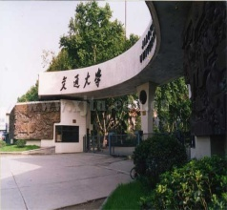
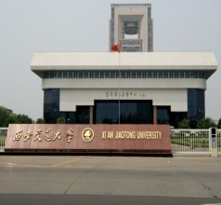
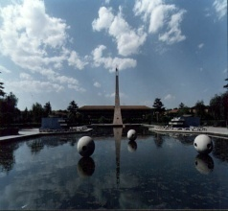
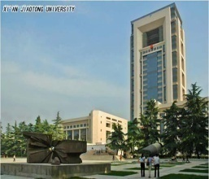
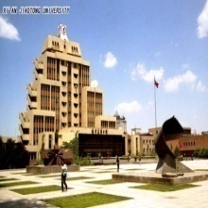

Computer Organization & Architecture
Li Chen
Office: A206
Tel: 13186134617
2023.9

Slide 2
Textbook and Reference
Computer Organization & Architecture
Designing for Performance (Eighth/Ninth Edition)
By William Stallings
计算机组织与体系结构性能设计（第7版/第8版/第10版）
张昆藏译/ 彭蔓蔓等/贺莲译
计算机组成与结构（第5版） 王爱英 主编
计算机组成原理（第6版） 白中英 主编
计算机组成原理（第3版） 唐朔飞 主编
计算机系统结构（第1版） 朱利 主编
深入理解计算机系统（原书第3版） 龚奕利译

Slide 3
Web resources
http://WilliamStallings.com/COA/COA9e.html
http://WilliamStallings.com/StudentSupport.html
Intel Developer’s Page
ARM: https://www.arm.com/
Top500 Supercomputer Site

Slide 4
SPOC
本课程的SPOC(计算机原理与体系结构)已经在雨课堂上线了
链接：西安交通大学 (yuketang.cn)
线上学习成绩占比:30%
线下期末考核成绩占比:60%
线下作业考核成绩占比:10%
课后作业提交及批改在学堂在线平台

Slide 5
Course Features
What about this course
  Specify the computer architecture and components
  How to organize these components
  Best optimizing the performance of whole computer
Main courses involved
  Digital Logic
  Operating System
  Assemble Language

Slide 6
Why is this course needed ?
Fundamental course for programmer
  A course containing more hardware than software
  Instruction for further learning hardware
The ideas and principles contained in this course can be often used in programming
Common knowledge
  Programmer should hold necessary hardware of computer

Slide 7
Studying methods
Attend lecture earnestly
Review and digest in time (just after the class)
Complete our homework
Frequently consult the related Web site and know about the latest information

Slide 8
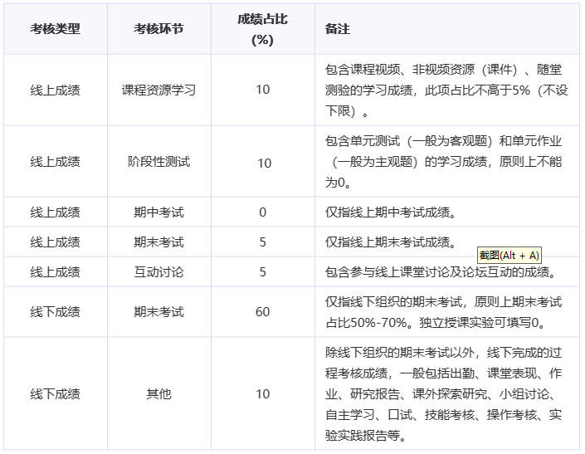
Examination
Final mark：
  Online: 30%; Final: 60%; Homework (Offline):10%
Attitude is anything!

Slide 9
Goals
Specialty and professional English
Reading carefully the book
Remember the basic concepts and important principles
After our class, we can read science and technology literatures without dictionary
Write thesis abstract right

Slide 10
Contents
Part1: Overview
Part2: Computer system
Part3: CPU
Part4: CU
Part5: Parallel organization
18/17 chapters
Chapter 8 —— learned by yourself

Slide 11
Online Contents
第3章计算机功能和互联
第10章 指令集特征和功能
第11章 指令集寻址方式和指令格式
第17章 并行组织

Slide 12
Part One: Overview
Chapter 1: Introduction
  Introducing the computer components and their functions
Chapter 2: Computer Evolution and Performance

Slide 13
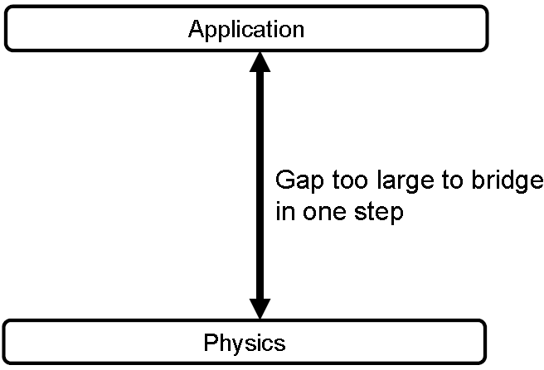
1.1 Organization & Architecture
Computer architecture:

Slide 14
Ch. 1 – 1.1
Computer architecture:
  Def.1： design of the abstraction layers that allow us to implement information processing applications efficiently using available manufacturing technologies.
  Def.2：attributes visible to a programmer
    These attributes have a direct impact on the logical execution of a program
    Conceptual structure and function characteristic

Slide 15
Ch. 1 – 1.1
Computer Organization
  Def.1：The operational units (components) and their interconnection that realize the architectural specifications
  Def.2：Fundamental attributes visible to a system designer
    An implementation of the architecture

Slide 16
Ch. 1 – 1.1
Computer architecture refers to logical design of a computer; while computer organization is implementation of this logical design
  For example, whether a computer will have a multiplication function, it is an architecture issue; while how to implement the multiplier belongs to the organization concept

Slide 17
Ch. 1 – 1.1
Computer Implementations
  Def.1: Physical implementations of computer components in organization
  Def.2: The hardware out of which we make computer systems
  Transparent to programmers
Transparency/Transparent:
  For existed things or attributes, from a point of view, they are looked as not existed, this concept is called transparency

Slide 18
Ch. 1 – 1.1
Architectural attributes:
  {instruction set，word length，I/O mechanism，addressing，etc}
Organizational attributes:
  {control signal，interface，memory technology，bus technology，… hardware details transparent to programmer}
Implement attributes:
  {Integrated Circuits (ICs), Printed Circuits (PC) boards, Power Supplies, Chassis, Connectors and Cables，etc}

Slide 19
Ch. 1 – 1.1
Series Computers: computers with the same architecture and different organization
  IBM System/370 architecture
    Was introduced in 1970
    Has survived to this day as the architecture of IBM’s mainframe product line
(Software) compatibility/compatible:
  The software can operate in all computers with the same architecture.
    The result is the same, difference exists in running time

Slide 20
Ch. 1 – 1.1
Upward compatibility：program for low level computer can run over high level computer without modification
Backward compatibility：program for current computer can run over future computer without modification

Slide 21
1.2 Structure and Function
Computer is a complex system
  Millions of basic electronic components
How to describe a computer?
  Hierarchical system
    Set of interrelated subsystems
At each level, only structure and function are concerned for the designer

Slide 22
Ch. 1 – 1.2
Structure : the way in which components relate to each other in certain level
Function : the operation of individual components as part of the structure
Top-down approach to describe

Slide 23
Ch. 1 – 1.2
All computer functions are:
  Data processing
  Data storage
  Data movement
  Control

Slide 24
Ch. 1 – 1.2
A Functional view of the computer
Data
Storage
Facility
Data
Movement
Apparatus
Control
Mechanism
Data
Processing
Facility

Slide 25
Ch. 1 – 1.2
Data movement
  e.g. phoning
Data
Storage
Facility
Data
Movement
Apparatus
Control
Mechanism
Data
Processing
Facility

Slide 26
Ch. 1 – 1.2
Data Storage
  e.g. Internet download to disk
Data
Storage
Facility
Data
Movement
Apparatus
Control
Mechanism
Data
Processing
Facility

Slide 27
Ch. 1 – 1.2
Data Processing from/to storage
  e.g. PS a picture
Data
Storage
Facility
Data
Movement
Apparatus
Control
Mechanism
Data
Processing
Facility

Slide 28
Ch. 1 – 1.2
Processing from storage to I/O
  e.g. dealing by ATM
Data
Storage
Facility
Data
Movement
Apparatus
Control
Mechanism
Data
Processing
Facility

Slide 29
Ch. 1 – 1.2
Structure - Top Level
Peripherals
Computer
Central
Processing
Unit
Main
Memory
Computer
Storage
Processing
Systems
Interconnection
Input
Output
Communication
lines

Slide 30
Ch. 1 – 1.2
CPU
CPU
Computer
Arithmetic
and
Logic Unit
I/O
Registers
System
Bus
CPU
Internal CPU
Interconnection
Memory
Control
Unit

Slide 31
Ch. 1 – 1.2
CU
Control Unit
CPU
ALU
Sequencing
Logic
Internal
Bus
Control
Unit
Control Unit
Registers and
Decoders
Registers
Control
Memory

Slide 32
Ch. 1 – 1.2
Why study this course?
  In some degree, it teaches how we play game in cost and performance.
  As a designer, we can program a processor that is embedded in some real-time or larger system.

Slide 33
Vocabulary
Central Processing Unit:中央处理单元/CPU
Main memory：主存
I/O subsystem 输入/输出子系统
Interconnection：互连
Component：部件/组件
Arithmetic and logic unit：算术逻辑单元
Register：寄存器
Single-chip microcomputer：单片机
Integrated circuit：集成电路

Slide 34
Vocabulary
Architecture & organization：组成与系统结构
Attribute ： 属性
Programmer：程序员
Instruction set：指令集
Addressing memory：可寻址内存
Interface：接口
Transparency：透明性
Peripheral：外设

Slide 35
Vocabulary
Compatibility：兼容性
Reduced instruction set computer：
  精简指令集计算机/RISC
Short-term data storage：短时数据存储
Long -term data storage：长时数据存储
Processor：处理器
Parallel and pipeline ：并行与流水
Microprogram :微程序

Slide 36
Key points
  What is the computer organization & architecture?
  Transparency
  What are computer functions
  Main components in a normal computer
  Main components in CPU and CU

